Slide 1
Scrum Framework
Soon Phei Tin

Slide 2
Objectives
This chapter provides an overview of the Scrum framework with a primary focus on its practices, including roles, activities, and artifacts

Slide 3
Overview
Scrum is not a standardized process
Scrum is a framework for organizing and managing work.
The Scrum framework is based on a set of values, principles, and practices that provide the foundation to which your organization will add its unique implementation of relevant engineering practices and your specific approaches for realizing the Scrum practices

Slide 4
Overview
Imagine that the Scrum framework is like the foundation and walls of a building
The Scrum values, principles, and practices would be the key structural components
You can customize inside the structure of Scrum, adding fixtures and features until you have a process that works for you
Scrum is a simple, people-centric framework based on the values of honesty, openness, courage, respect, focus, trust, empowerment, and collaboration
The Scrum practices themselves are embodied in specific roles, activities, artifacts, and their associated rules

Slide 5
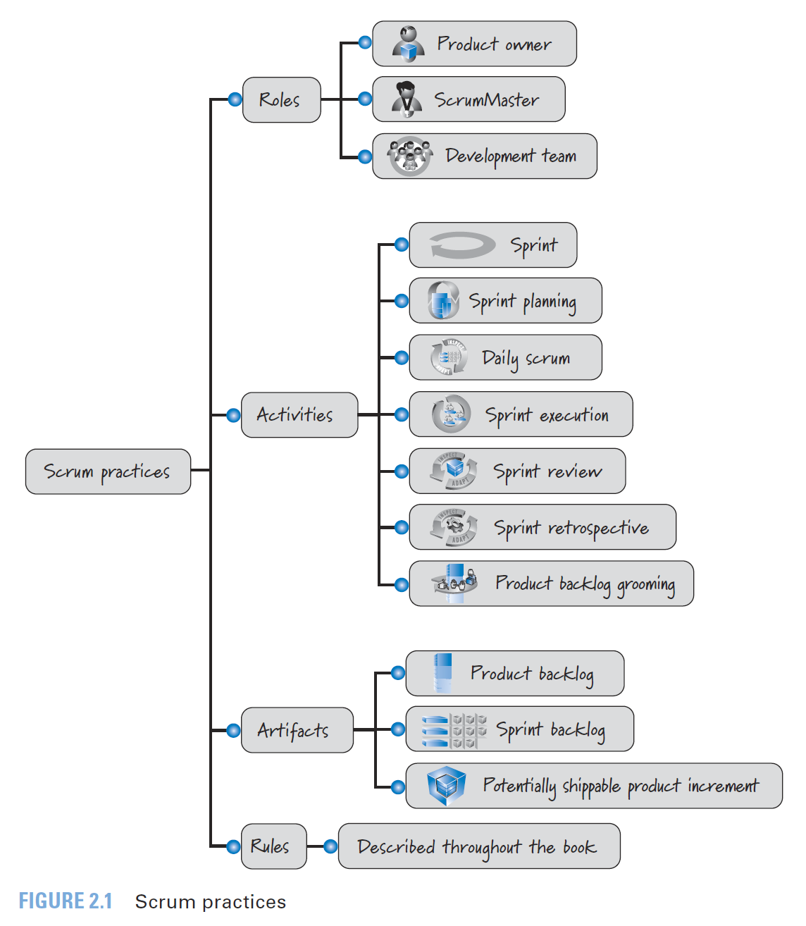
Overview

Slide 6
Scrum Roles
Scrum development efforts consist of one or more Scrum teams
Each made up of three Scrum roles: product owner, ScrumMaster, and the development team
The product owner is responsible for what will be developed and in what order
The Scrum Master is responsible for guiding the team in creating and following its own process based on the broader Scrum framework
The development team is responsible for determining how to deliver what the product owner has asked for

Slide 7
Product Owner
The single authority responsible for deciding which features and functionality to build and the order in which to build them
The product owner maintains and communicates to all other participants a clear vision of what the Scrum team is trying to achieve
The product owner is responsible for the overall success of the solution being developed or maintained.

Slide 8
Product Owner
To make sure that the most valuable work is always performed
The product owner actively collaborates with the ScrumMaster and development team
Must be available to answer questions soon after they are posed

Slide 9
ScrumMaster
Helps everyone involved understand and embrace the Scrum values, principles, and practices
Acts as a coach, providing process leadership and helping the Scrum team and the rest of the organization develop their own high performance, organization-specific Scrum approach
The ScrumMaster helps the organization through the challenging change management process that can occur during a Scrum adoption.

Slide 10
ScrumMaster
As a facilitator, the ScrumMaster helps the team resolve issues and make improvements to its use of Scrum
Also responsible for protecting the team from outside interference and takes a leadership role in removing impediments that inhibit team productivity
The ScrumMaster has no authority to exert control over the team, so this role is not the same as the traditional role of project manager or development manager
The ScrumMaster functions as a leader, not a manager

Slide 11
Development Team
Scrum defines the role of a development team, which is simply a diverse, cross-functional collection of people who are responsible for designing, building, and testing the desired product
The development team self-organizes to determine the best way to accomplish the goal set out by the product owner
The development team is typically five to nine people in size
Its members must collectively have all of the skills needed to produce good quality, working software
For development efforts that require much larger team size, team members can be organized into several teams with each team nine or fewer team members

Slide 12
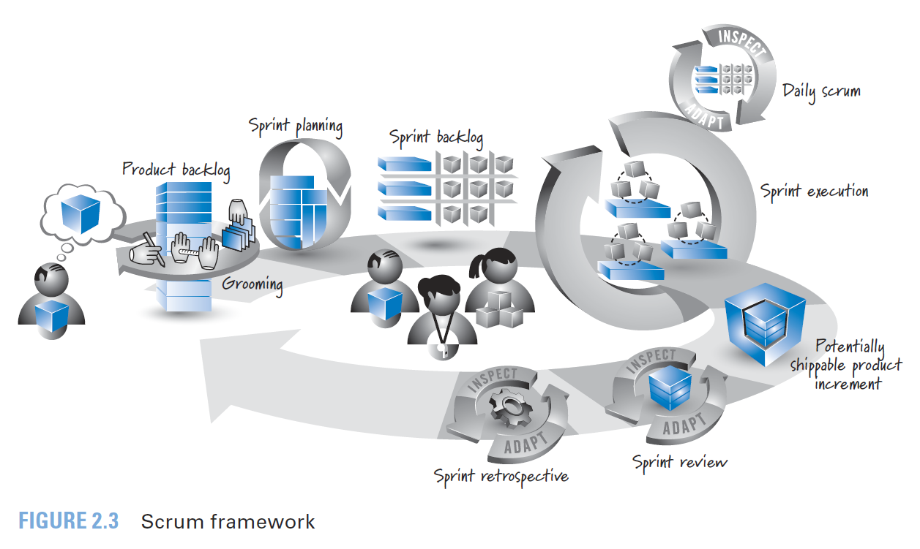
Scrum Activities and Artifacts

Slide 13
Forecast? Commitment?
It is a forecast because the estimate might change as more information becomes known during the course of the sprint
Some also believe that a commitment on the part of the team will cause the team to sacrifice quality to meet the commitment
Or will cause the team to “under-commit” to guarantee that the commitment is met.

Slide 14
Forecast? Commitment?
using the forecast to derive a commitment
Commitments support mutual trust between the product owner and the development team as well as among the development team
Commitments support reasonable short-term planning and decision making within an organization
When performing multiteam product development, commitments support synchronized planning

Slide 15
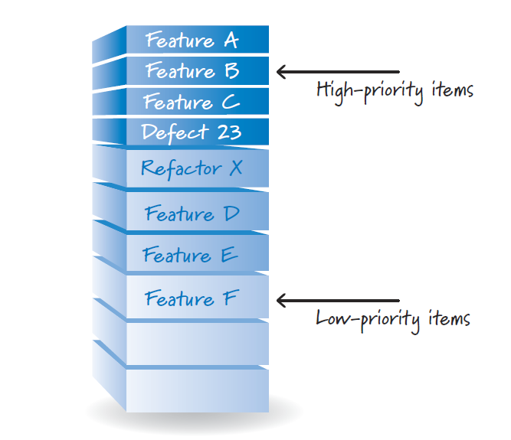
Product Backlog
The product owner, with input from the rest of the Scrum team and stakeholders, is ultimately responsible for determining and managing the sequence of works (product backlog items) and communicating it in the form of a prioritized (or ordered) list known as the product backlog

Slide 16
Product Backlog
On new-product development the product backlog items initially are features required to meet the product owner’s vision.
For ongoing product development, the product backlog might also contain new features, changes to existing features, defects needing repair, technical improvements, and so on.
Product owner collaborates with internal and external stakeholders to gather and define the product backlog items

Slide 17
Product Backlog
High-value items appear at the top of the product backlog and the lower-value items appear toward the bottom.
The product backlog is a constantly evolving artifact. Items can be added, deleted, and revised by the product owner as business conditions change, or as the Scrum team’s understanding of the product grows
In practice, many teams use a relative size measure such as story points or ideal days to express the item size

Slide 18
PBI Example
User Story: Online user registration
Description: As a user, I want to be able to register online, so that I can perform online shopping
Acceptance Criteria:
User can register only if the user fills in all required fields
The email used in the registration must not be a free email
User will receive a notification email after successful registration

Slide 19
PBI Example
User Story: Search for customer
Description: As a marketing manager, I would like to search for customers, so that I can call them
Acceptance Criteria:
Positive test: When I enter “Eddie” in the search box and click the search button, I will see all entries containing Eddie in a grid
Negative test: When I enter “ABC” in the search box and click the search button, I will see no entries in the grid
Gold plating: If no result, display a message
Gold plating: If a large set of results being returned, display in pagination
Gold plating: The user can click on the column heading of the grid to sort the information

Slide 20
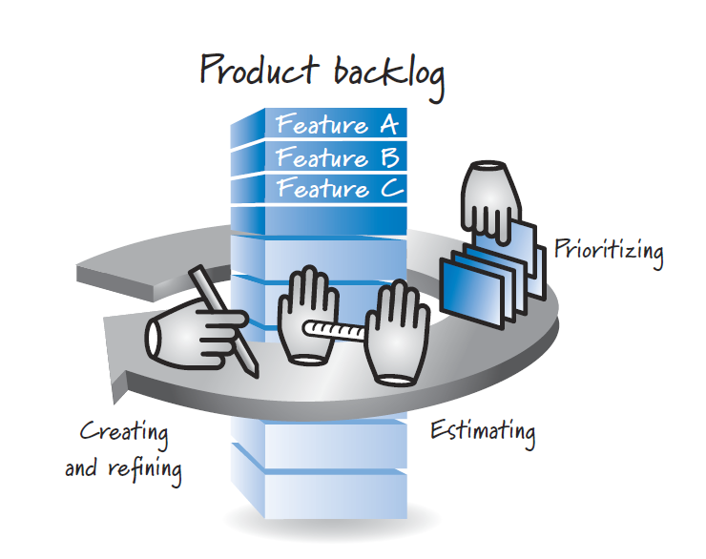
Product Backlog Grooming
The activity of creating and refining product backlog items, estimating them, and prioritizing them is known as grooming

Slide 21
Scrum Activities and Artifacts

Slide 22
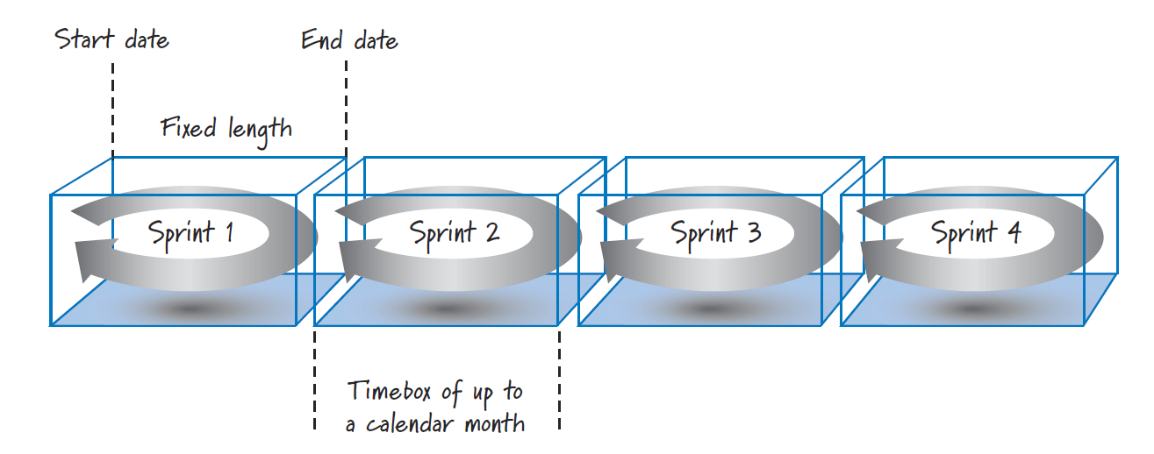
Sprint
In Scrum, work is performed in iterations or cycles of up to a calendar month called sprints
The work completed in each sprint should create something of tangible value to the customer or user
Sprints are timeboxed so they always have a fixed start and end date, and generally
They should all be of the same duration
A new sprint immediately follows the completion of the previous sprint

Slide 23
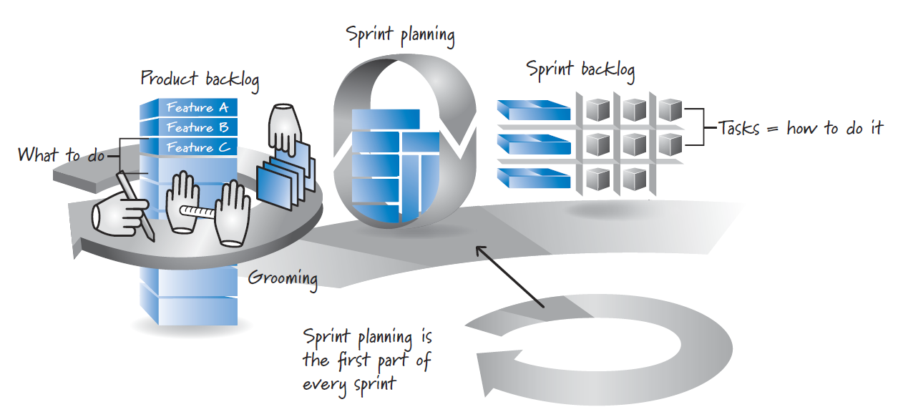
Sprint Planning
A product backlog may represent many weeks or months of work. To complete all the items in the product backlog, a series of sprints are to be carried out
To determine the most important subset of product backlog items to build in the next sprint, the product owner, development team, and ScrumMaster perform sprint planning

Slide 24
Sprint Planning
During sprint planning, the product owner and development team agree on a sprint goal that defines what the upcoming sprint is supposed to achieve
Based on the sprint goal, the development team reviews the product backlog and determines the high priority items that the team can realistically accomplish in the upcoming sprint while working at a sustainable pace

Slide 25
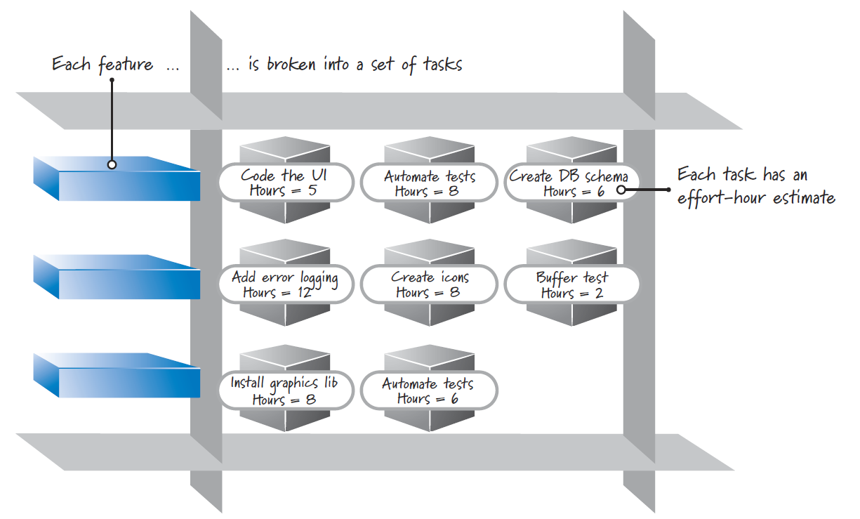
Sprint Planning
Many development teams break down each targeted feature into a set of tasks. The collection of these tasks, along with their associated product backlog items, forms a second backlog called the sprint backlog
The team provides an estimate (typically in hours) of the effort required to complete each task

Slide 26
Sprint Planning
In summary: Select a product backlog item (whenever possible, the next-most-important item as defined by the product owner), break the item down into tasks, and determine if the selected item will reasonably fit within the sprint (in combination with other items targeted for the same sprint). If it does fit and there is more capacity to complete work, repeat the cycle until the team is out of capacity to do any more work.

Slide 27
Sprint Execution
Once the Scrum team finishes sprint planning and agrees on the content of the next sprint, the development team performs all of the task-level work necessary to get the features done
“done” means there is a high degree of confidence that all of the work necessary for producing good-quality features has been completed.
Team members define their own task-level work and then self-organize in any manner they feel is best for achieving the sprint goal

Slide 28
Daily Scrum
Each day of the sprint, ideally at the same time, the development team members hold a timeboxed (15 minutes or less) daily scrum
This inspect-and-adapt activity is sometimes referred to as the daily stand-up because of the common practice of everyone standing up during the meeting to help promote brevity

Slide 29
Daily Scrum
ScrumMaster facilitating and each team member taking turns answering three questions:
What did I accomplish since the last daily scrum?
What do I plan to work on by the next daily scrum?
What are the obstacles or impediments that are preventing me from making progress?
The purpose is for everyone to understands the big picture of what is occurring, how they are progressing toward the sprint goal, any modifications they want to make to their plans for the upcoming day’s work, and what issues need to be addressed.

Slide 30
Daily Scrum
Not a problem-solving activity
Talk about problems after the daily scrum and do so with a small group of interested member
Not a traditional status meeting,
Communicate the status of sprint backlog items among the development team members
It is an inspection, synchronization, and adaptive daily planning activity that helps a self-organizing team do its job better.

Slide 31
Definition of Done
sprint results as a potentially shippable product increment, meaning that whatever the Scrum team agreed to do is really done according to its agreed-upon definition of done
This definition specifies the degree of confidence that the work completed is of good quality and is potentially shippable.
A bare-minimum definition of done should yield a complete slice of product functionality that is designed, built, integrated, tested, and documented

Slide 32
Definition of Done
“potentially shippable” does not mean that what got built must actually be shipped.
Shipping is a business decision, which is frequently influenced by things such as:
Do we have enough features or enough of a customer workflow to justify a customer deployment?
Can our customers absorb another change given that we just gave them a release two weeks ago?

Slide 33
Sprint Review
At the end of the sprint there are two additional inspect-and-adapt activities, sprint review and sprint retrospective
Sprint review is to inspect and adapt the product that is being built.
Critical to this activity is the conversation that takes place among its participants, which include the Scrum team, stakeholders, sponsors, customers, and interested members of other teams.
Focused on reviewing the just-completed features in the context of the overall development effort.
Everyone in attendance gets clear visibility into what is occurring and has an opportunity to help guide the forthcoming development to ensure that the most business-appropriate solution is created.

Slide 34
Sprint Retrospective
The second inspect-and-adapt activity at the end of the sprint
Frequently occurs after the sprint review and before the next sprint planning
Sprint retrospective is an opportunity to inspect and adapt the process
The development team, ScrumMaster, and product owner discuss what is and is not working with Scrum and associated technical practices.
The focus is on the continuous process improvement
At the end of a sprint retrospective the Scrum team should have identified and committed to a practical number of process improvement actions

